Slide 1

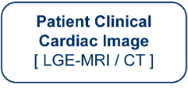

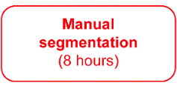

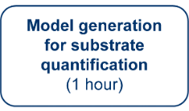
Left Atrium Right Atrium Network (LARANet)
A Deep Neural Network for Biatrial Segmentation from MRI and CT Images
Rebecca A. Yu, Rheeda L. Ali PhD, Pallavi Pandey MD, Ryan P. Bradley PhD, David D. Spragg MD FHRS, Hugh G. Calkins MD FHRS, Natalia A. Trayanova PhD FHRS
OBJECTIVE
1 Clinical Motivation
atrial segmentation bottleneck

Slide 2
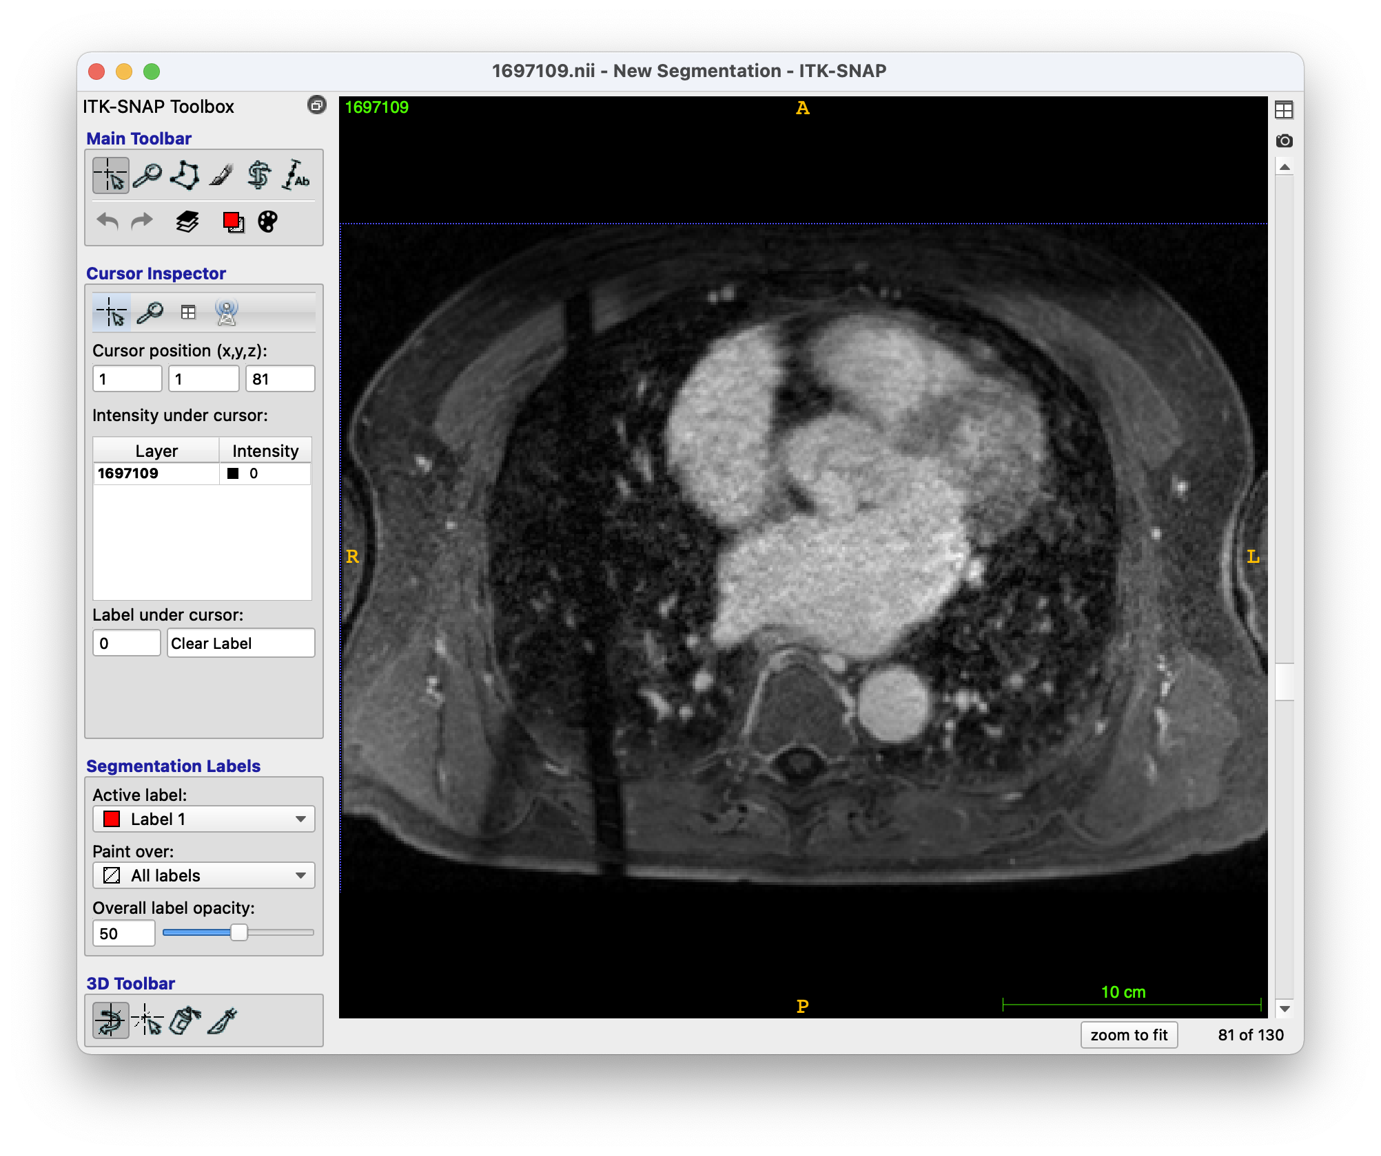
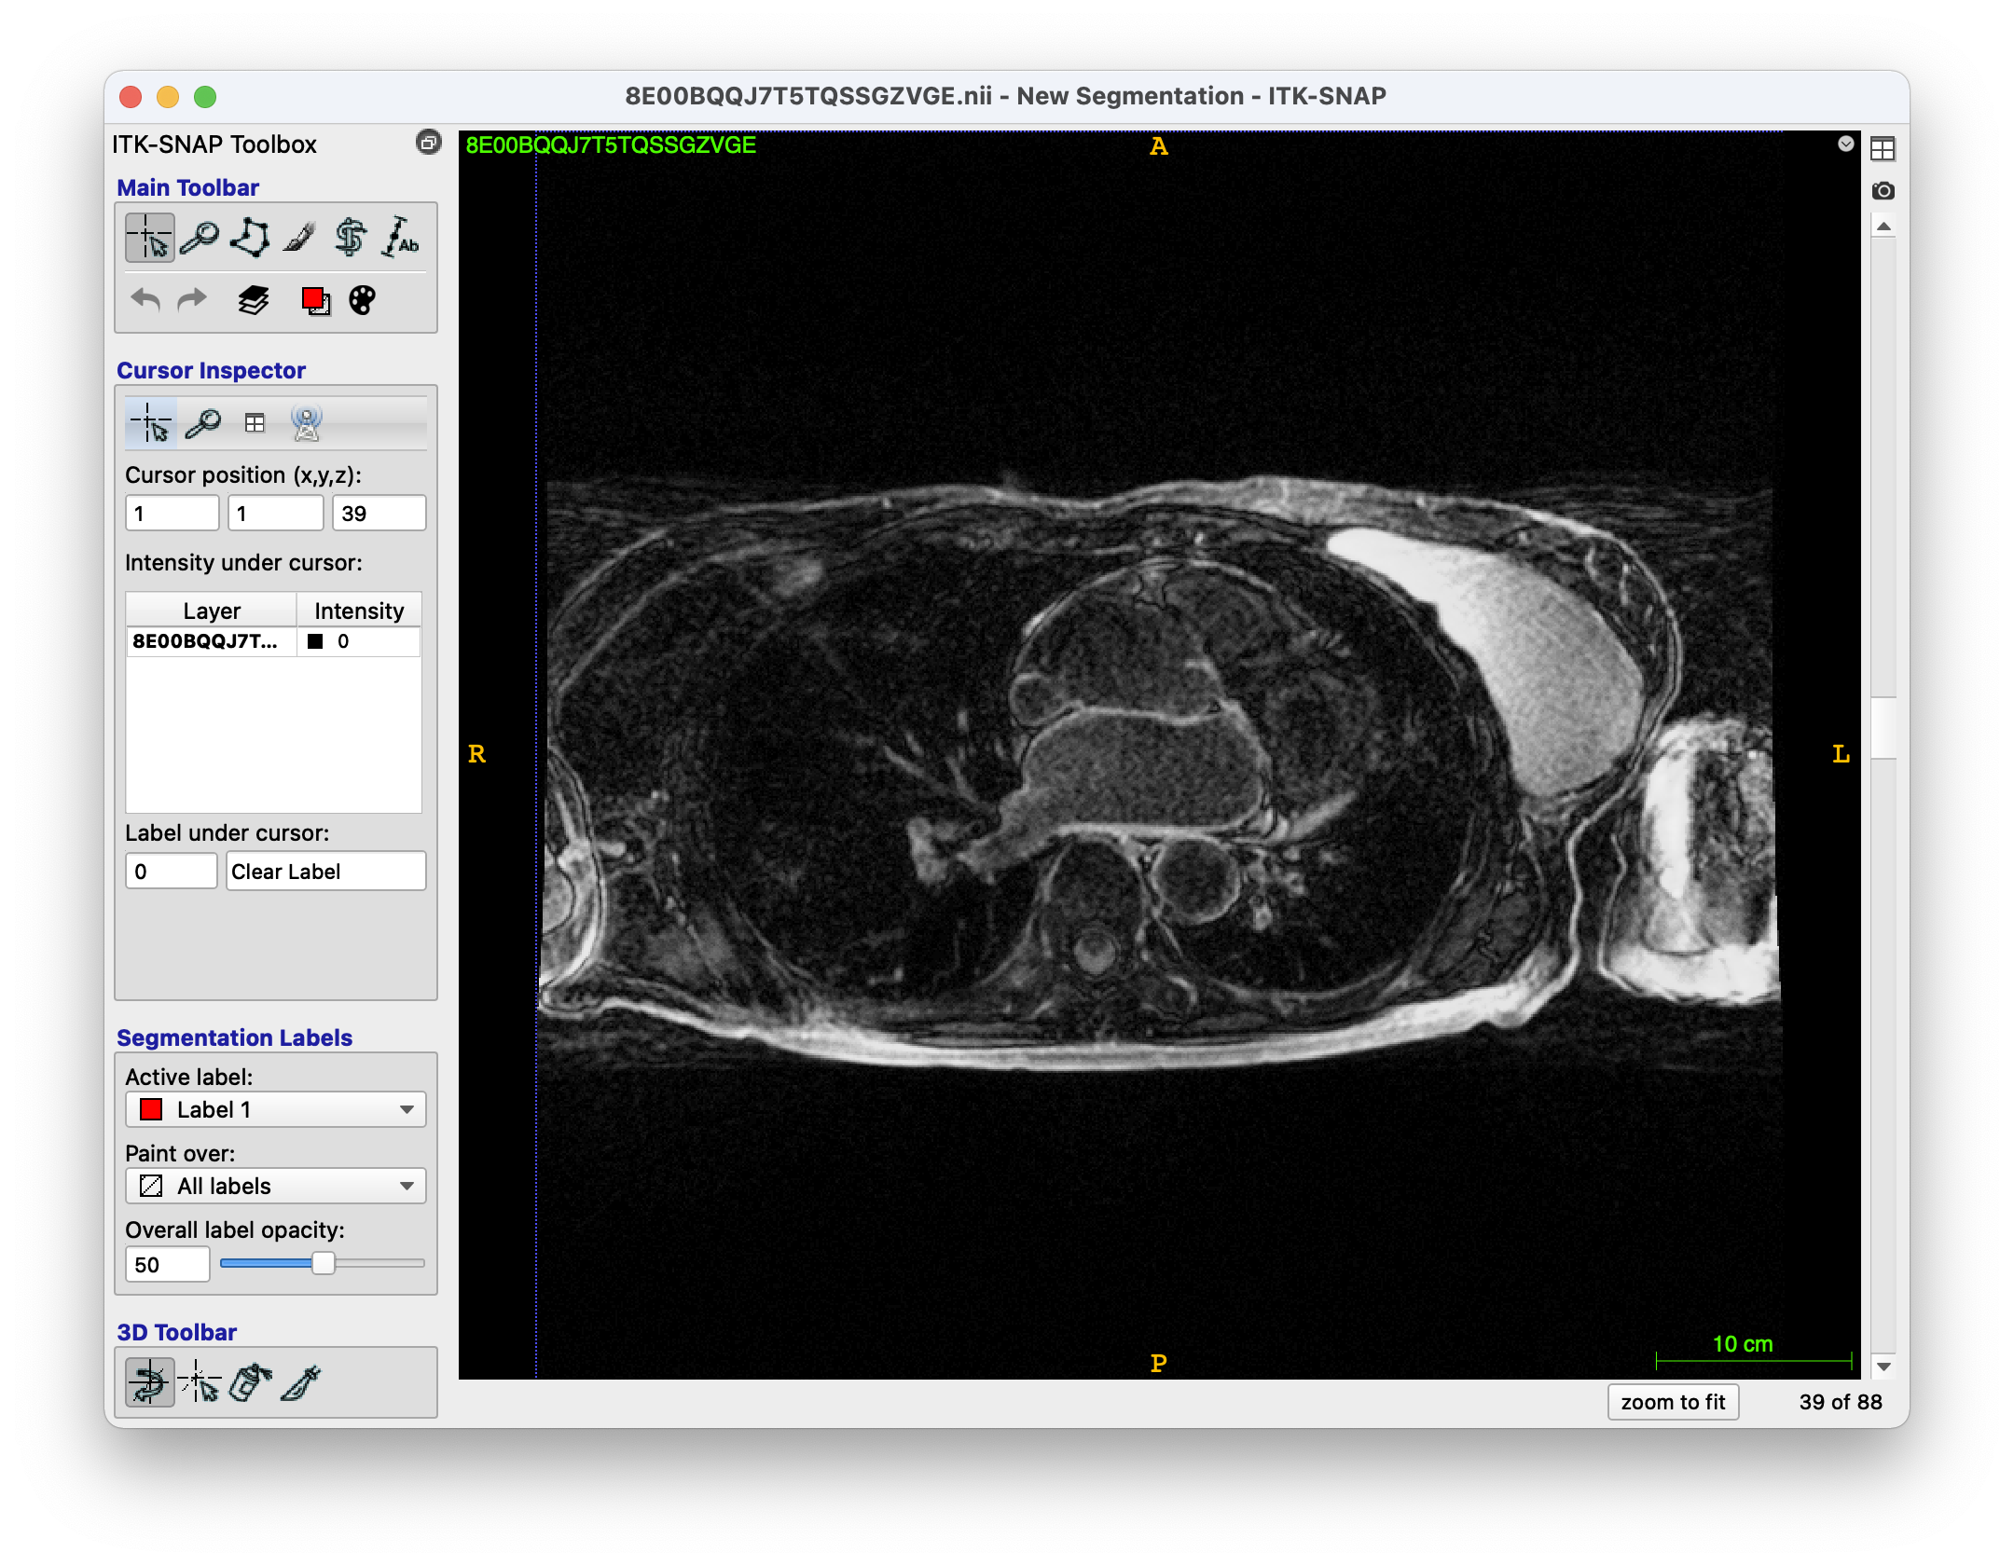
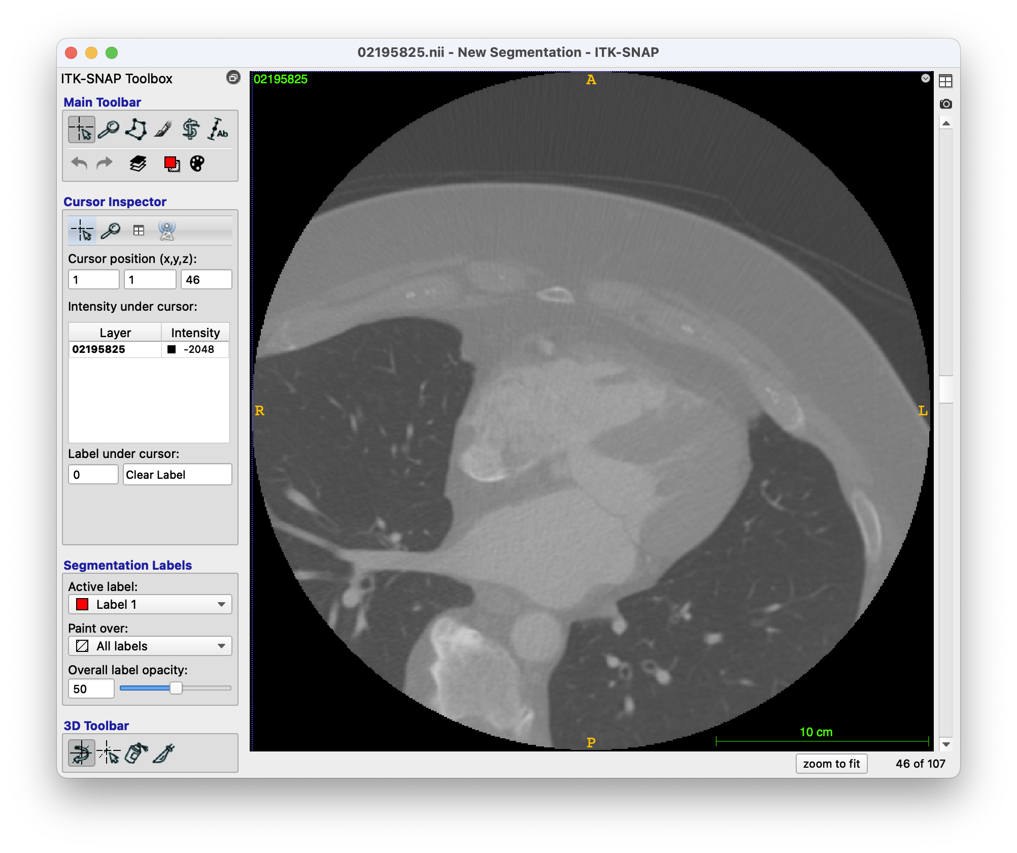
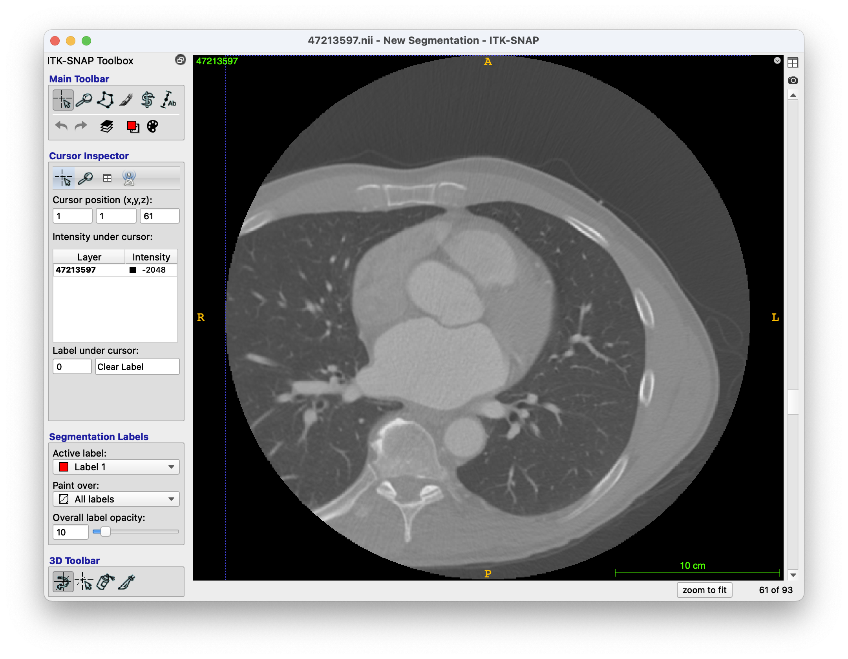
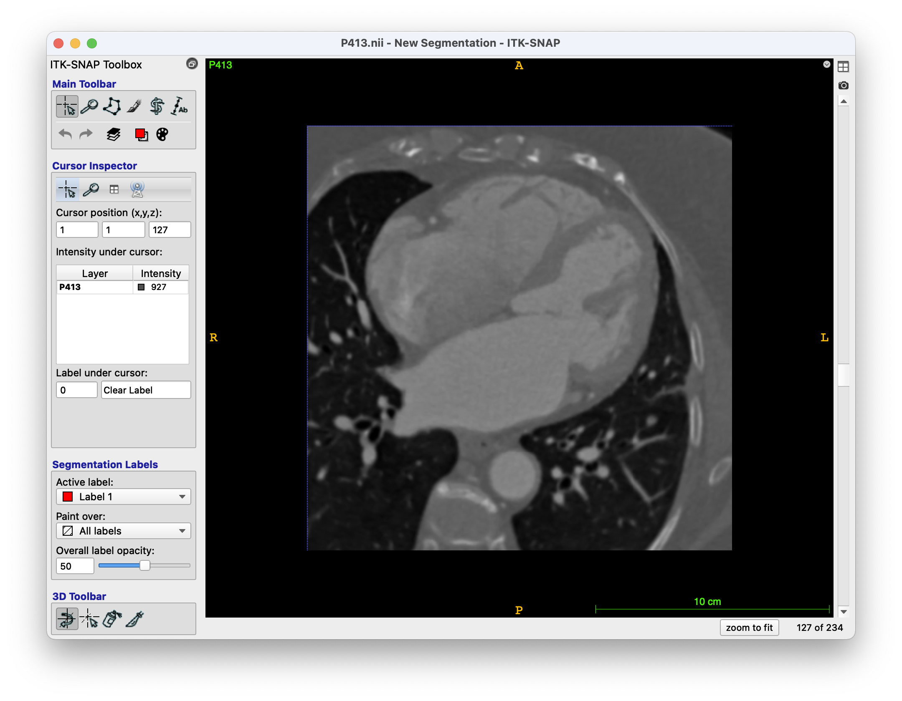
Left Atrium Right Atrium Network (LARANet)
A Deep Neural Network for Biatrial Segmentation from MRI and CT Images
Rebecca A. Yu, Rheeda L. Ali PhD, Pallavi Pandey MD, Ryan P. Bradley PhD, David D. Spragg MD FHRS, Hugh G. Calkins MD FHRS, Natalia A. Trayanova PhD FHRS
OBJECTIVE
1 Clinical Motivation
atrial segmentation bottleneck
2 Technical Motivation
low NN generalizability

Slide 3
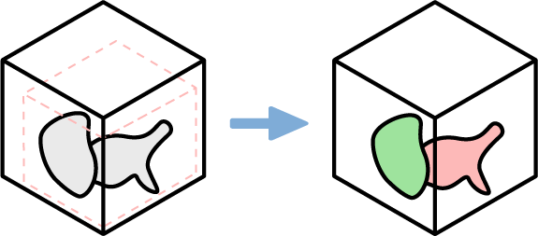
Left Atrium Right Atrium Network (LARANet)
A Deep Neural Network for Biatrial Segmentation from MRI and CT Images
Rebecca A. Yu, Rheeda L. Ali PhD, Pallavi Pandey MD, Ryan P. Bradley PhD, David D. Spragg MD FHRS, Hugh G. Calkins MD FHRS, Natalia A. Trayanova PhD FHRS
OBJECTIVE
1 Clinical Motivation
atrial segmentation bottleneck
2 Technical Motivation
low NN generalizability
3 Technical Background
ROI-dependent segmentations

Slide 4
Left Atrium Right Atrium Network (LARANet)
A Deep Neural Network for Biatrial Segmentation from MRI and CT Images
Rebecca A. Yu, Rheeda L. Ali PhD, Pallavi Pandey MD, Ryan P. Bradley PhD, David D. Spragg MD FHRS, Hugh G. Calkins MD FHRS, Natalia A. Trayanova PhD FHRS
OBJECTIVE
1 Clinical Motivation
atrial segmentation bottleneck
2 Technical Motivation
low NN generalizability
3 Technical Background
ROI-dependent segmentations
AIM
Define and implement a biatrial segmentation NN that successfully segments LA and RA of never-before-seen clinical images with high anatomical consistency.

Slide 5
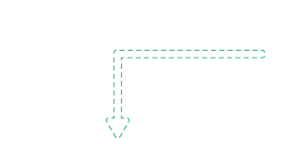
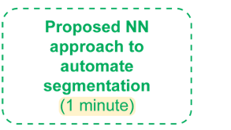
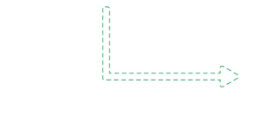
OBJECTIVE
1 Clinical Motivation
2 Technical Motivation
3 Technical Background
AIM
Define and implement a biatrial segmentation NN that successfully segments LA and RA of never-before-seen clinical images with high anatomical consistency.

Slide 6
OBJECTIVE
1 Clinical Motivation
2 Technical Motivation
3 Technical Background
AIM
Define and implement a biatrial segmentation NN that successfully segments LA and RA of never-before-seen clinical images with high anatomical consistency.

Slide 7
AIM
Define and implement a biatrial segmentation NN that successfully segments LA and RA of never-before-seen clinical images with high anatomical consistency.

Slide 8
METHODS
Data
Model
Evaluation

Slide 9
METHODS
Data
Model
Evaluation

Slide 10
METHODS
Data
 | LA+RA
LGE-MRI | 91
CT | 78
Total | 169
LGE-MRI & CT images acquired at Johns Hopkins Hospital
Manual LA + RA segmentations
Mix of persistent and paroxysmal AF patients
70/20/10 data split
Model
Evaluation

Slide 11
METHODS
Data
Model
Evaluation

Slide 12
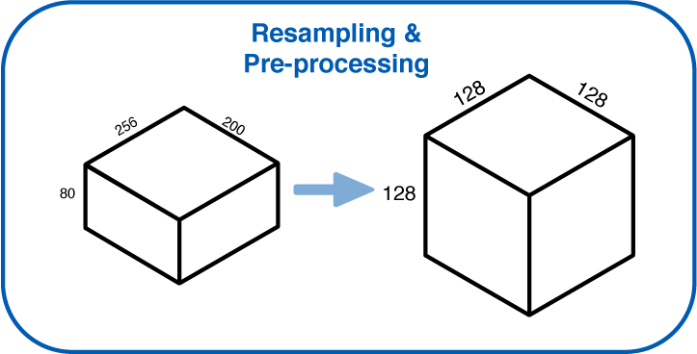
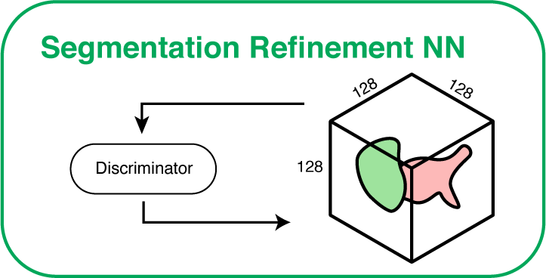


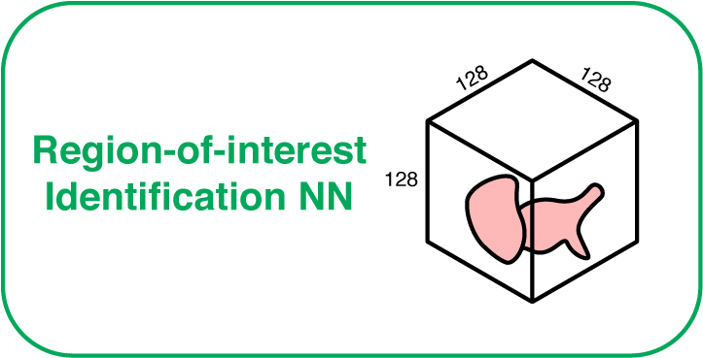
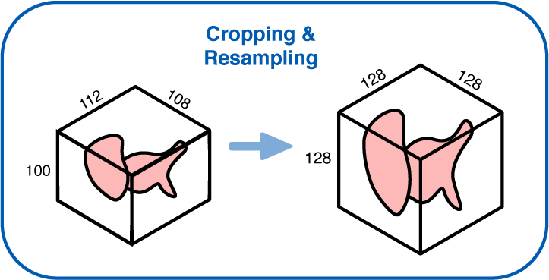

METHODS
Data
Model
Evaluation

Slide 13
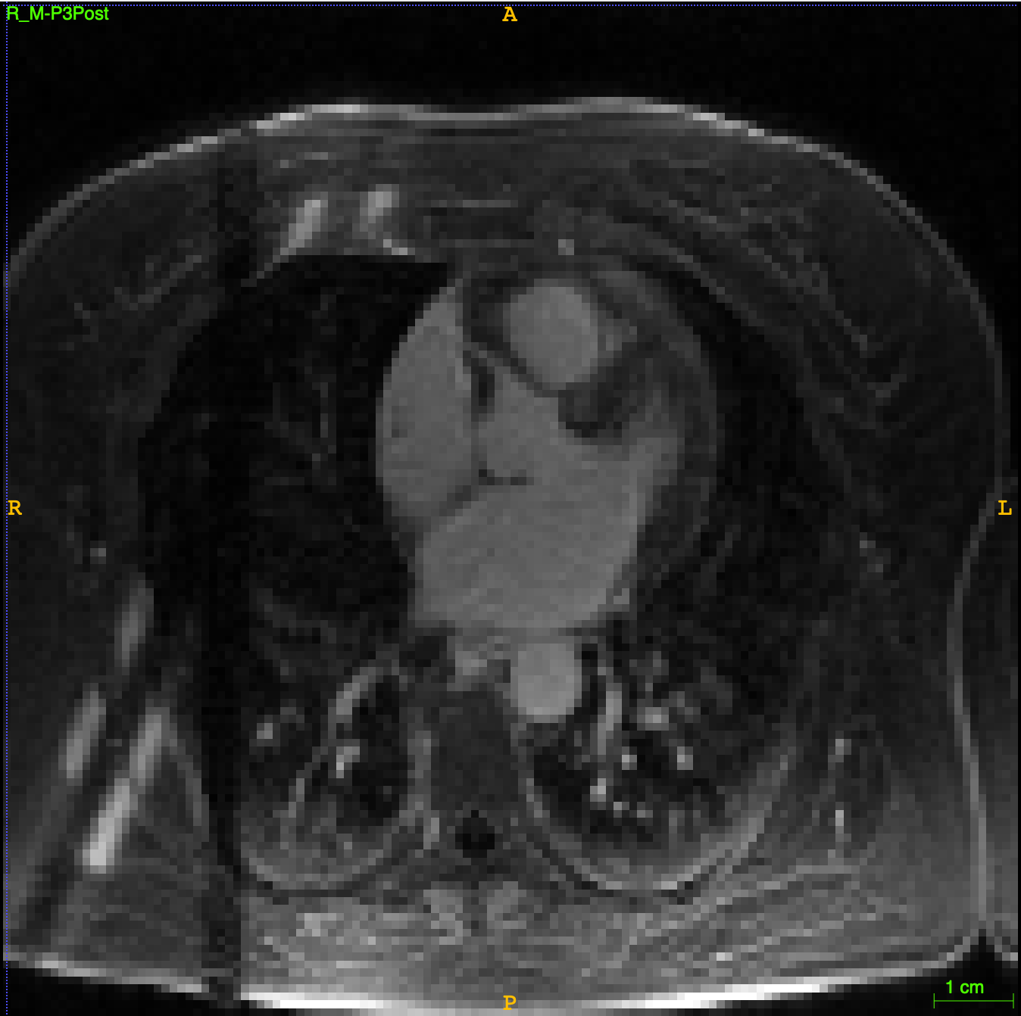
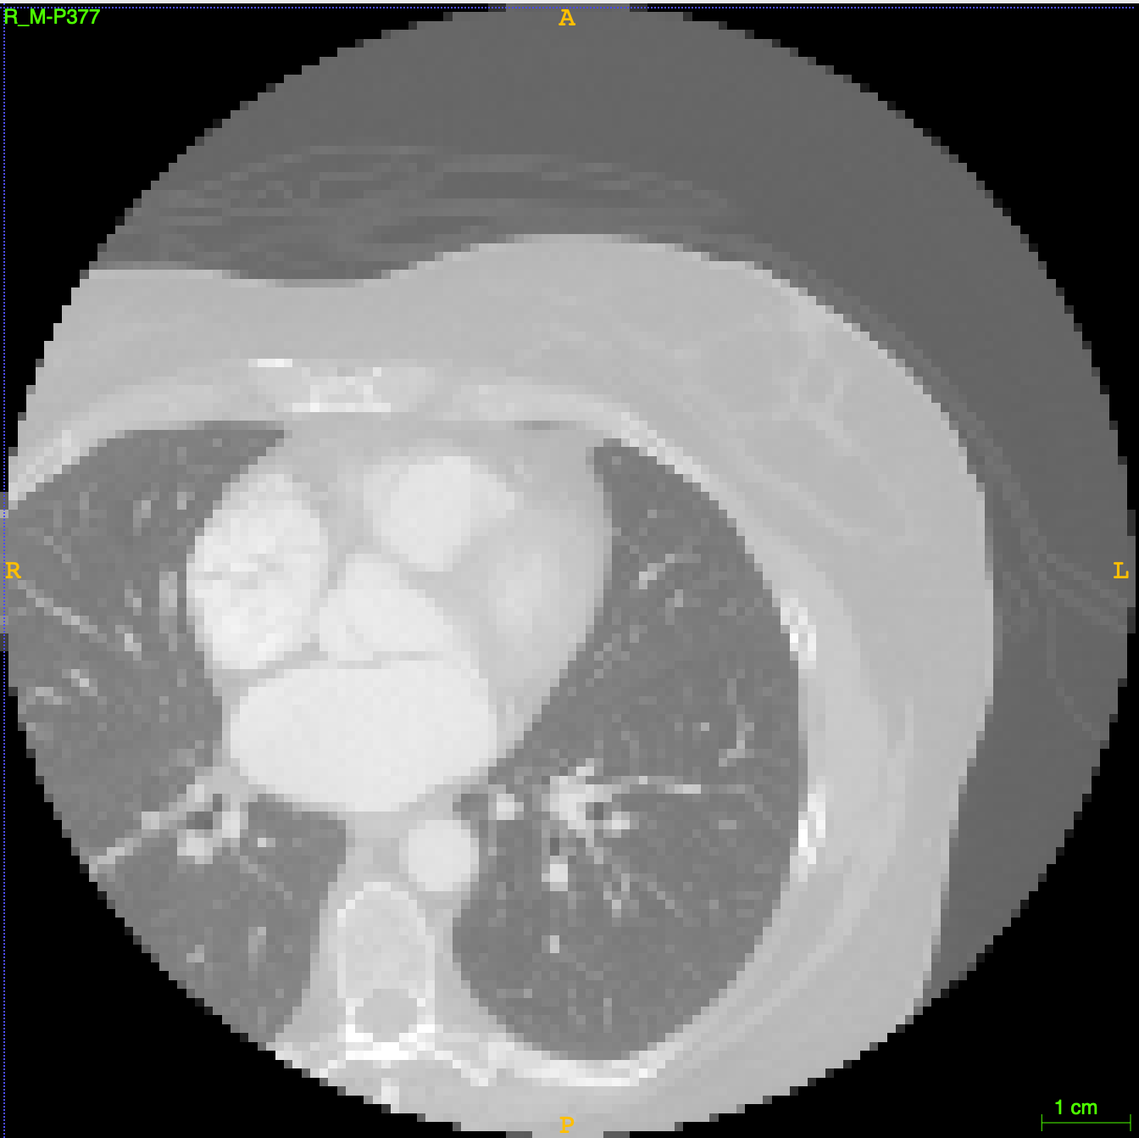
Model

Slide 14
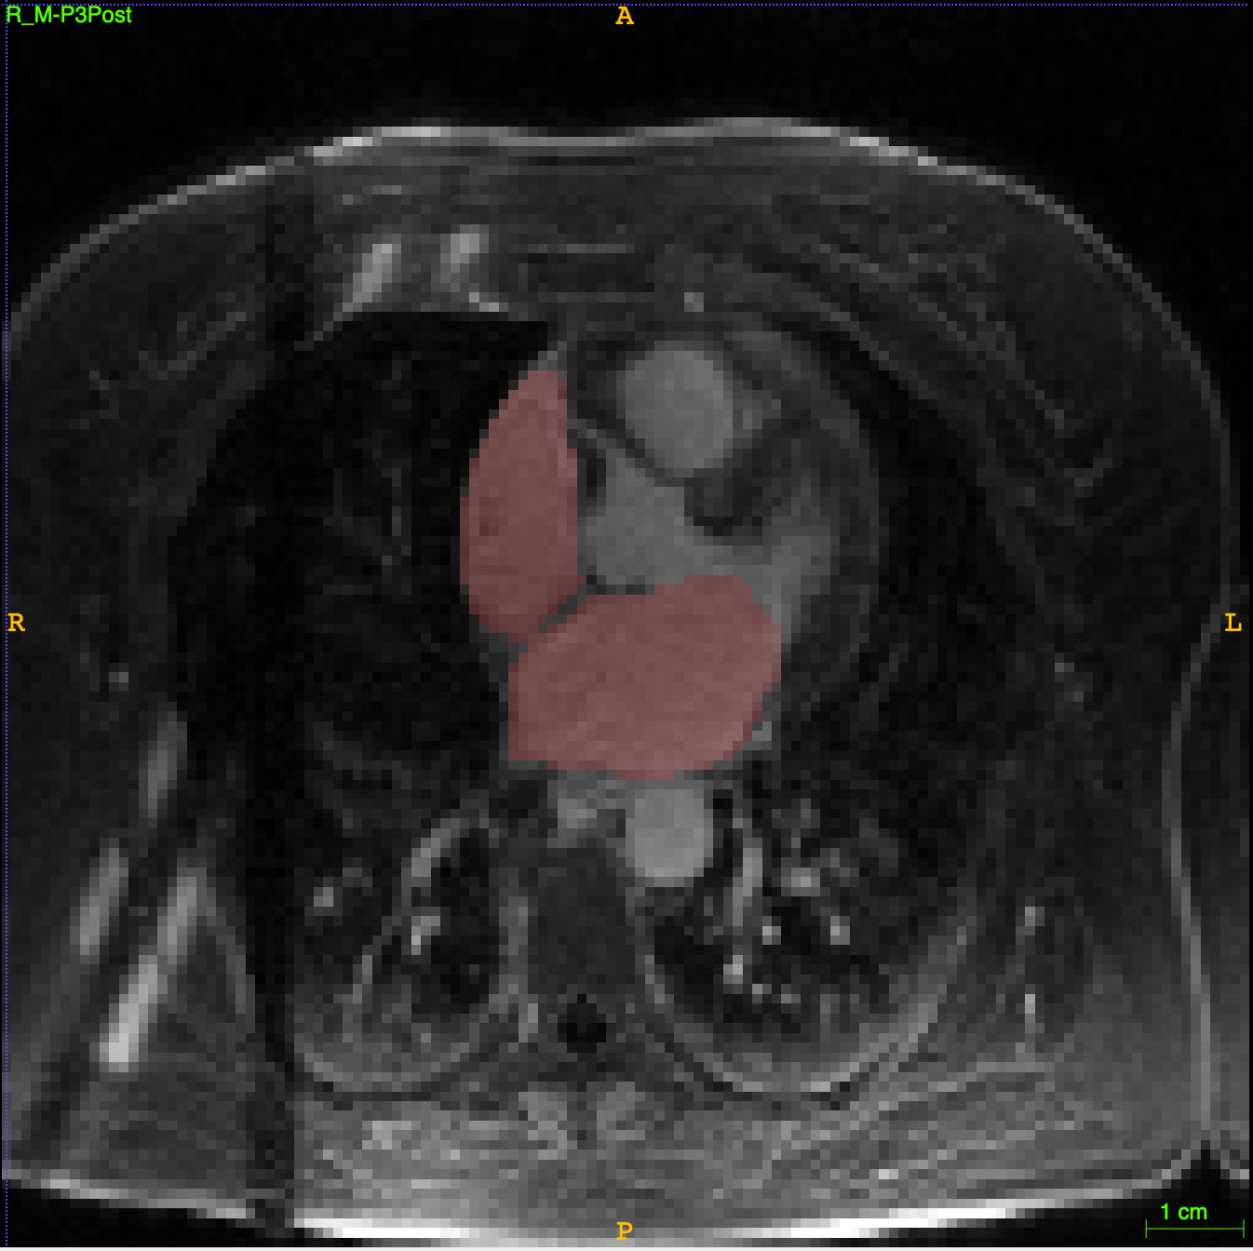
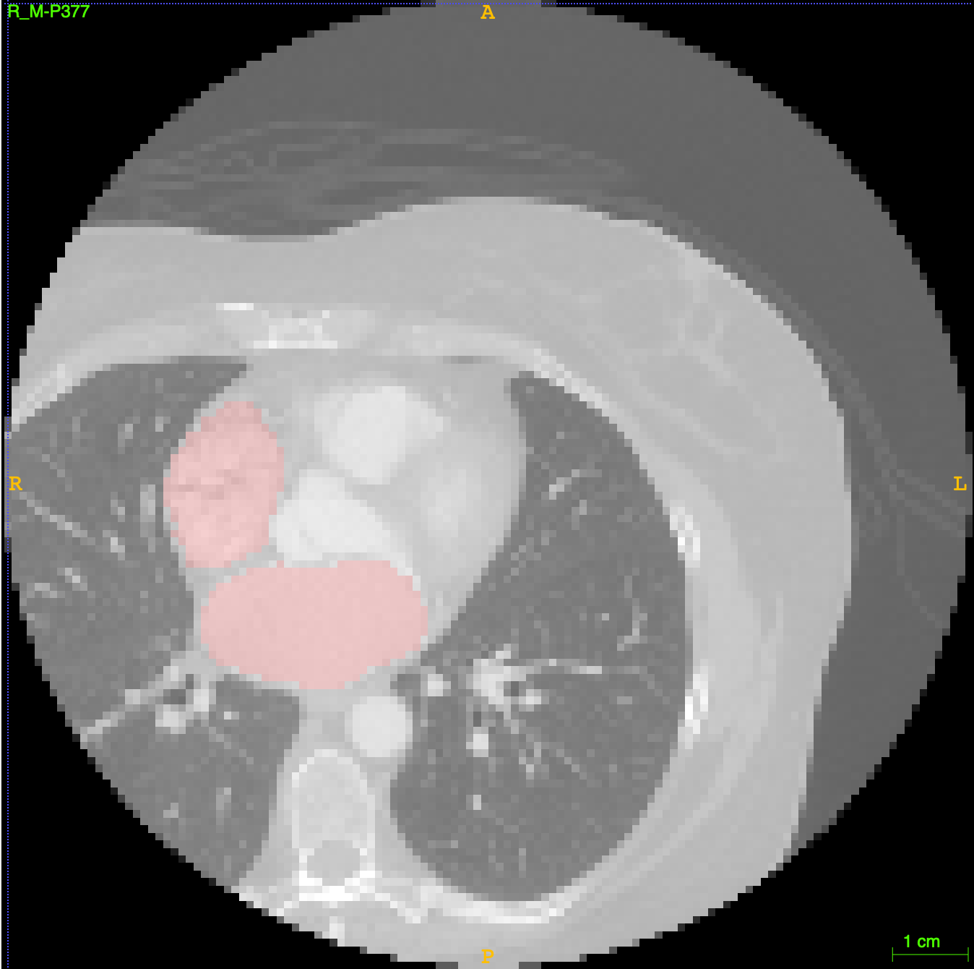
Model

Slide 15
Model

Slide 16
Model

Slide 17
Model

Slide 18
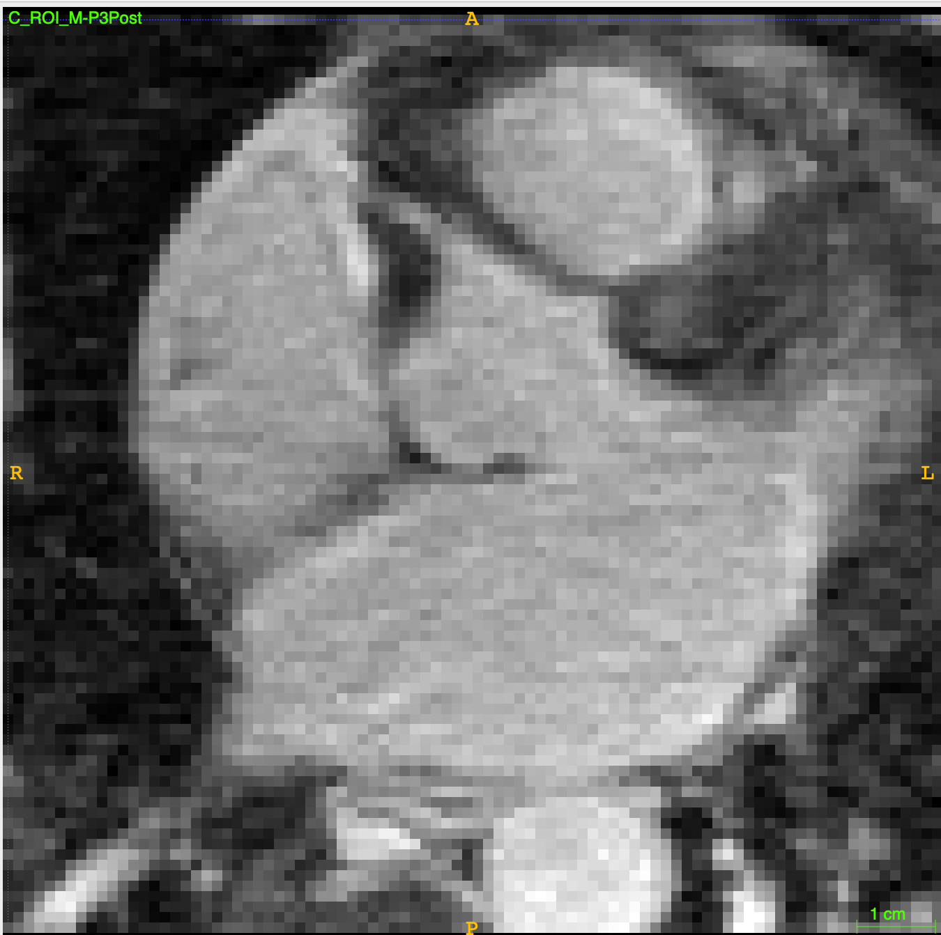
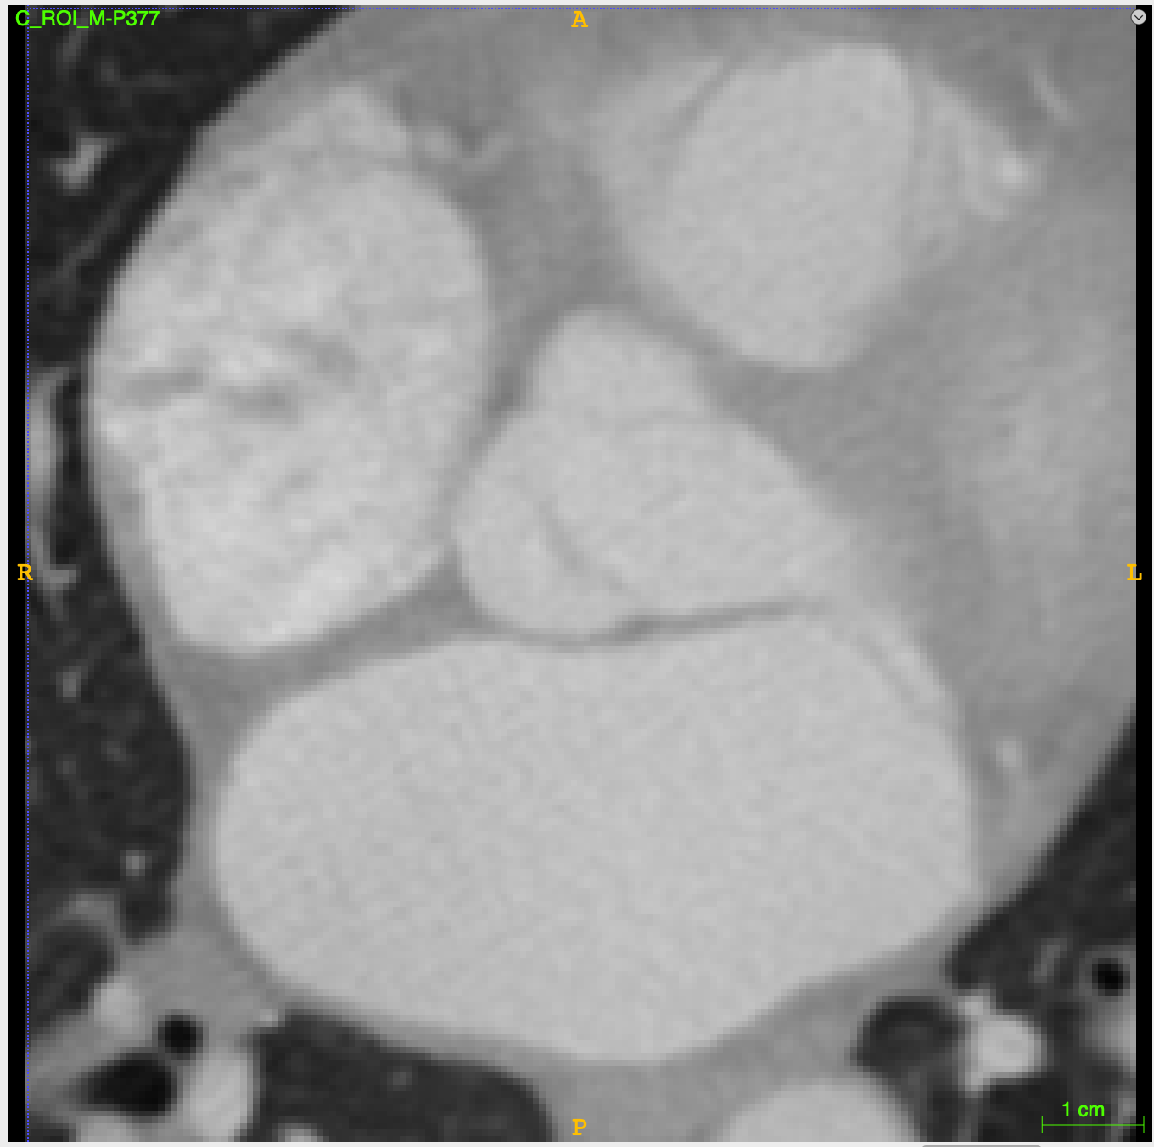
Model

Slide 19
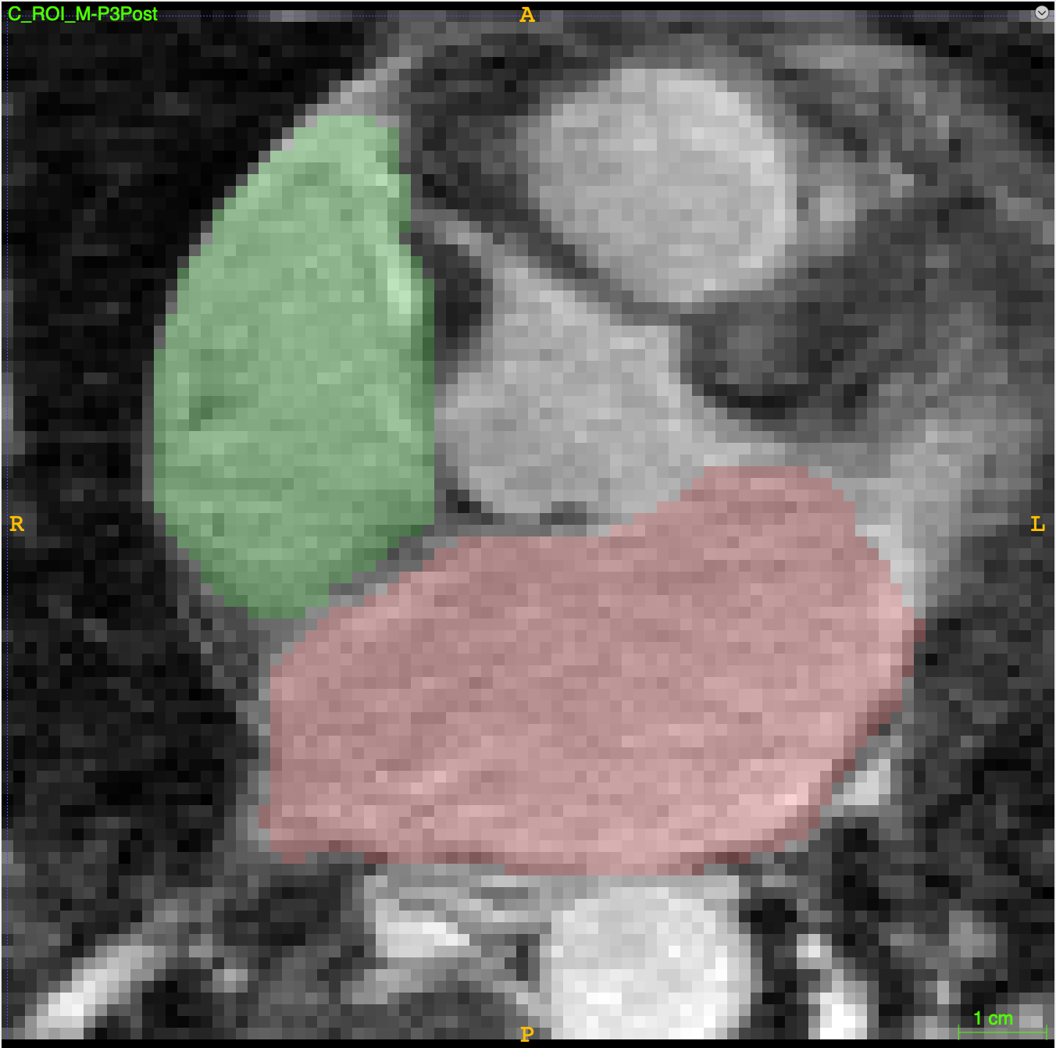
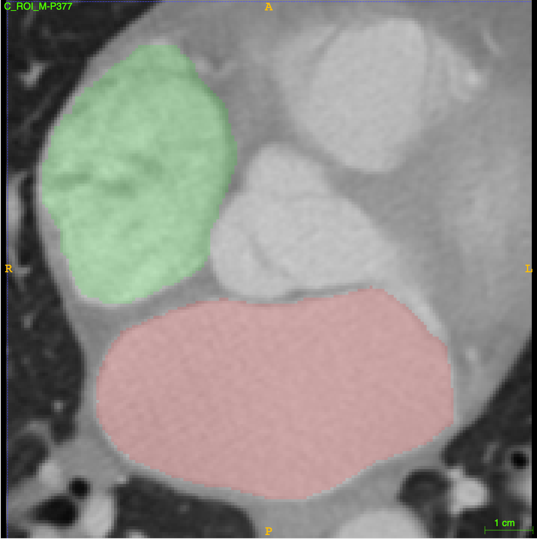
Model

Slide 20
Model

Slide 21
Model

Slide 22
Model

Slide 23
METHODS
Data
Model
Evaluation

Slide 24
METHODS
Data
Model
Evaluation

Slide 25
METHODS
Data
Model
Evaluation
Dice Coefficient

Slide 26
METHODS
Data
Model
Evaluation
Dice Coefficient
:
0

Slide 27
METHODS
Data
Model
Evaluation
Dice Coefficient
:
0.5

Slide 28
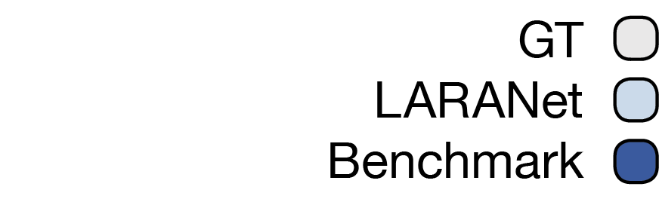
METHODS
Data
Model
Evaluation
Dice Coefficient
:
1
Benchmark DC:
0.961

Slide 29
METHODS
Data
Model
Evaluation
Dice Coefficient
Hausdorff Distance

Slide 30
METHODS
Data
Model
Evaluation
Hausdorff Distance
:
Low

Slide 31
METHODS
Data
Model
Evaluation
Hausdorff Distance
:
High

Slide 32
METHODS
Data
Model
Evaluation
Dice Coefficient
Hausdorff Distance
Anatomical Regions

Slide 33

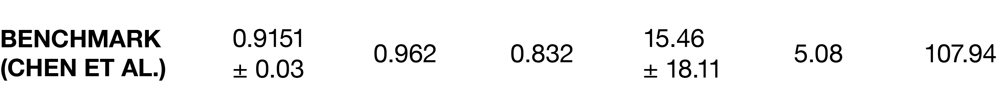



METHODS
Data
Model
Evaluation
RESULTS

Slide 34
METHODS
Data
Model
Evaluation
RESULTS
Dice Coefficient
:
0.964
Benchmark DC:
0.961

Slide 35

RESULTS
Dice Coefficient
:
0.964
Benchmark DC:
0.961

Slide 36
RESULTS

Slide 37
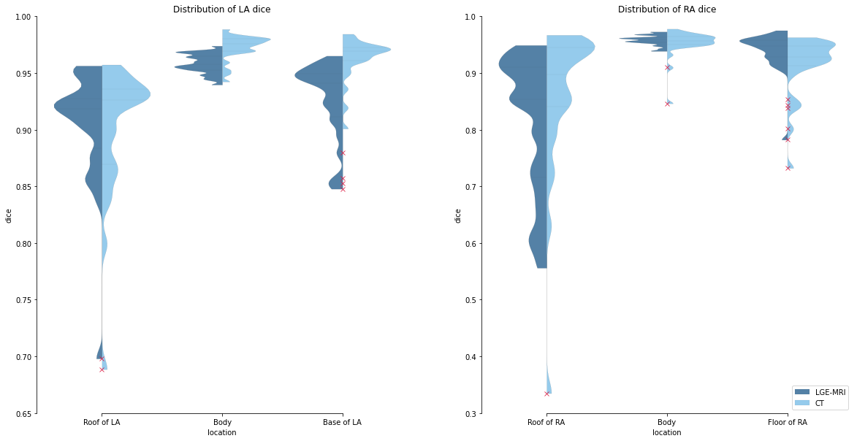
RESULTS

Slide 38
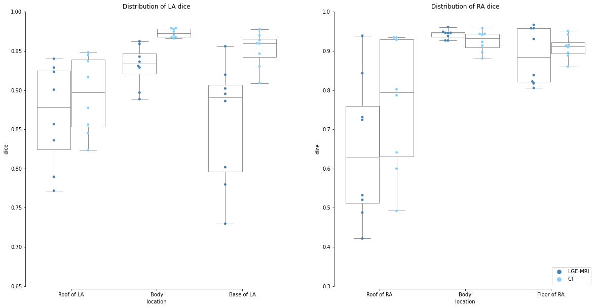

Slide 40
Thank You
Rebecca Yu
Undergraduate student
Johns Hopkins Biomedical Engineering, Computer Science
Supervisors: Dr. Natalia Trayanova, Dr. Rheeda Ali
ryu16@jhu.edu

